Slide 1
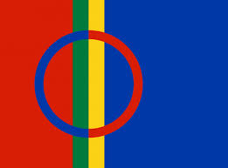
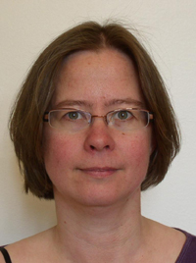
North Sámi Possessive Constructions in the Era of Truth and Reconciliation
Laura A. Janda
Lene Antonsen

Slide 2
Our Study of North Sámi Possessive Constructions...
Illustrates a two-way relationship between cognitive linguistics and an indigenous language:
Cognitive linguistics helps to document injustices perpetrated against an indigenous people
North Sámi sheds light on the semantics of possession

Slide 3
Overview
About North Sámi and Its Possessive Constructions
What Cognitive Linguistics Contributes to Documenting Discrimination
Longitudinal study of language change
What North Sámi Contributes to Understanding Possession
Emergence of a new alienable vs. inalienable distinction

Slide 4
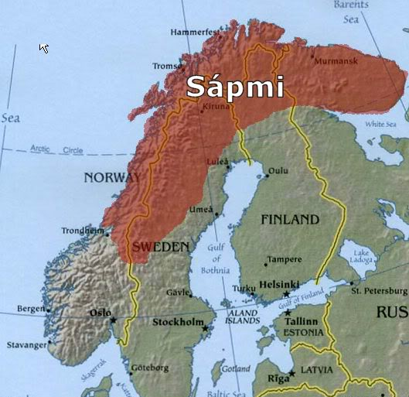
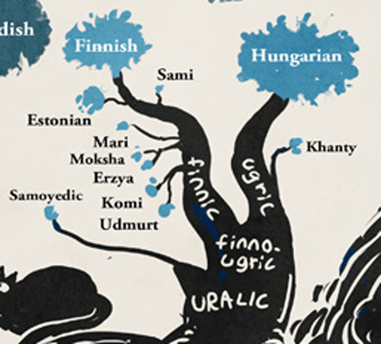
About North Sámi and Its Possessive Constructions
North Sámi is
a Finno-Ugric language
spoken by about 20,000 people
in a region they call Sápmi in northern Norway, Sweden, and Finland
Discriminatory policies in effect in all three countries until late 20th century, unofficial discrimination continues
Truth and Reconciliation Commissions established in Norway and Finland in 2018

Slide 5
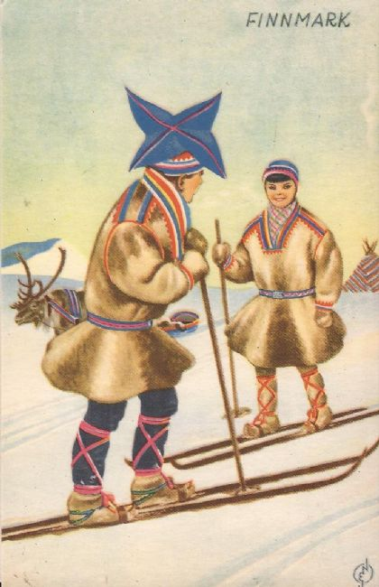
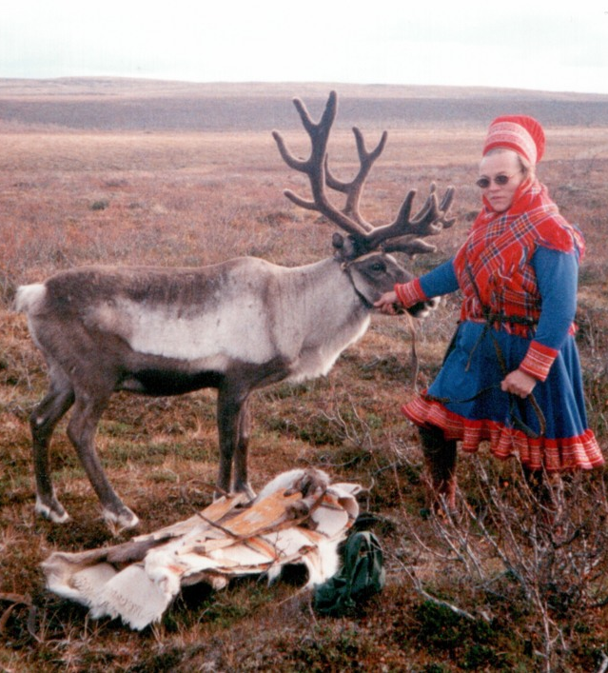
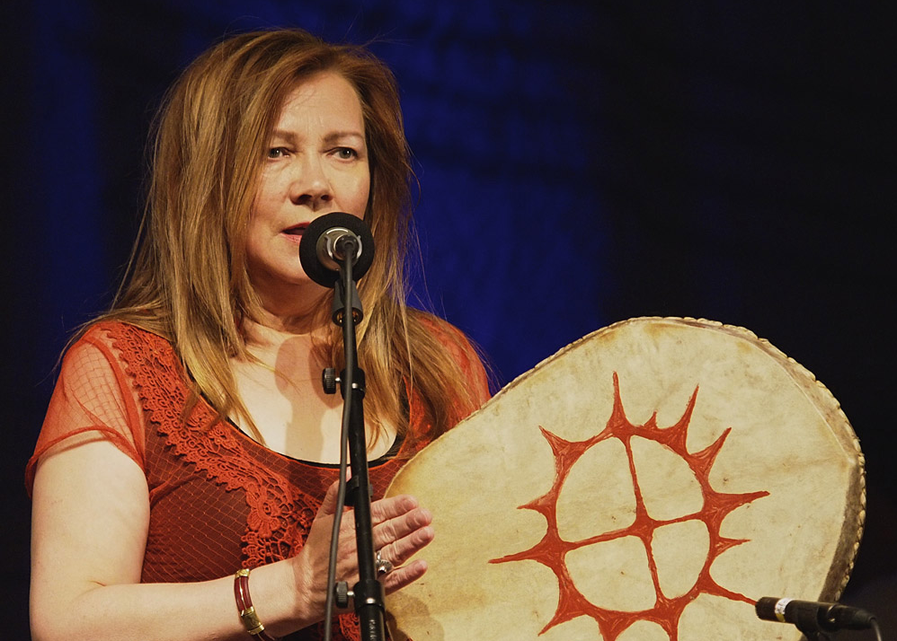
Facts about the Sámis
Fun Facts
Reindeer
Skis
Joik
Colorful Clothing
Far North
Morphologically Complex Language

Slide 6
Morphologically Complex:
boazu | geažus | feaskkir
bohccot | gehčosa | feaskáris
‘reindeer’ > NomPl ‘ending’ > GenSg ‘entryway’ > LocSg
diphthong reduction
consonant alternation
vowel alternation
case/number ending

Slide 7

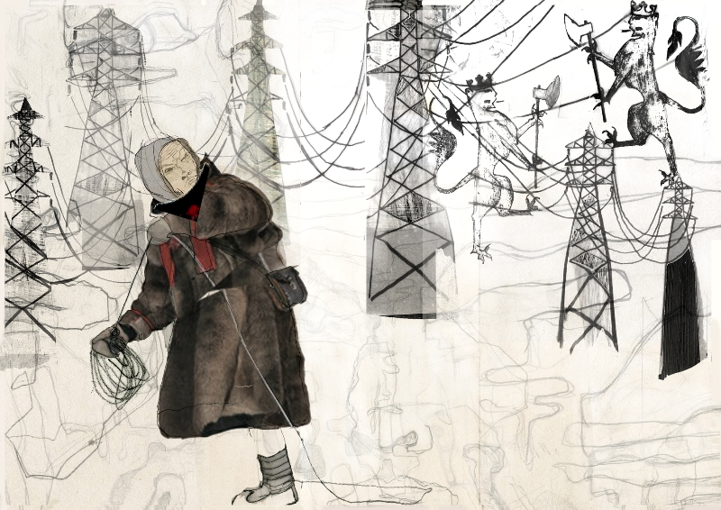
Facts about the Sámis
Not So Fun Facts
Threats to Reindeer
Residential Schools
Racism
Suicide
Climate Change
Threatened Language

Slide 8
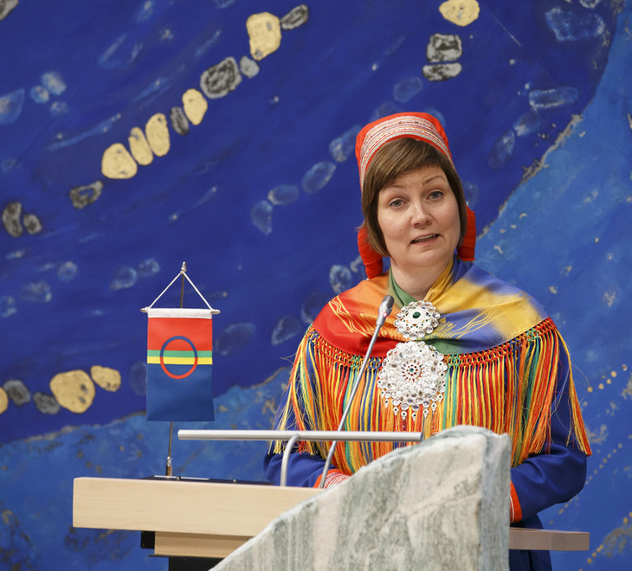
Threatened Language
Heterogeneous sociolinguistic landscape:
some native speakers; some heard or spoke N. Sámi as children, shifted to majority language during school years, later reacquired the language; other people learned the language as adults
Languages exposed to contact and adult learners tend toward morphological simplification, favoring analytic constructions (Trudgill 2002, and McWhorter 2007 & 2011, Bentz & Winter 2013)

Slide 9
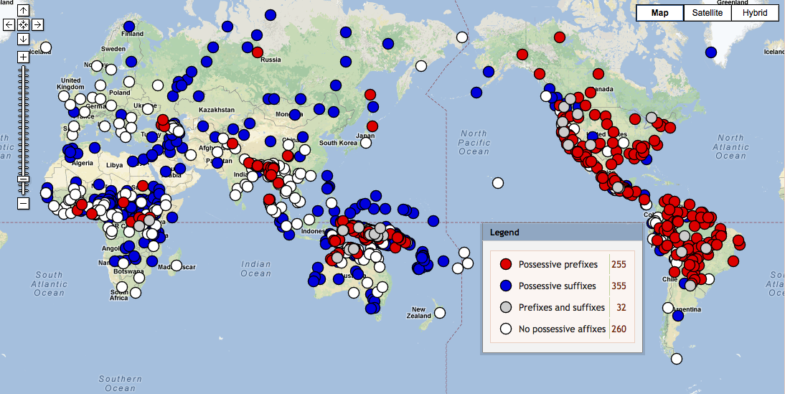
WALS Feature 57a: Possessive affixes
North Sámi

Slide 10
North Sámi Possessive Constructions: NPx and ReflN
ReflN = Reflexive genitive pronoun + Noun
Two examples from Elle Márjá Vars’ novel Kátjá
NPx (possessive suffix, HIGH morphological complexity):
(1a) Kátjá... ollii latnjasis
Kátjá.nom reach.ind.pret.3s room.ill.sg.px.3s
‘Kátjá... got to her room’
ReflN (analytic construction with reflexive genitive pronoun):
(1b) Kátjá... ollii iežas latnjii
Kátjá.nom reach.ind.pret.3s refl.gen.3s room.ill.sg
‘Kátjá... got to her room’
NPx = Noun + Possessive suffix

Slide 11
ReflN components = reflexive Genitive pronoun + noun inflection
Paradigm of reflexive genitive pronoun |  | Paradigm of noun guoibmi “partner”
1sg | ieža-n | nom.sg | guoibmi
2sg | ieža-t | gen.sg=acc.sg | guoimmi
3sg | ieža-s | ill.sg | guoibmá-i
1du | ieža-me | loc.sg | guoimmi-s
2du | ieža-de | com.sg=loc.pl | guimmi-in
3du | ieža-ska | nom.pl | guoimmi-t
1pl | ieža-met | gen.pl=acc.pl | guimmi-id
2pl | ieža-det | ill.pl | guimmi-ide
3pl | ieža-set | com.pl | guimmi-iguin
 |  | ess | guoibmi-n

Slide 12
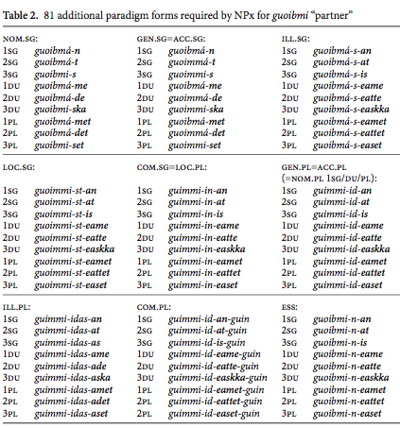
Use of NPx requires mastery of 81 additional unique forms, or a noun paradigm with 130 slots (instead of just 13), with additional complex morphophonemic alternations

Slide 13
Two Datasets
Longitudinal: >2K examples culled and annotated by hand from >.5M words representing literary works by authors from three generations
Loss of morphological complexity (Part 2)
Contemporary: >20K examples culled and annotated automatically with some manual cleaning from 9.5M word newspaper corpus from 1997-2010
Emergence of alienable/inalienable distinction (Part 3)

Slide 14
What Cognitive Linguistics Contributes to Documenting Discrimination
Author | Year of Birth | Geography | Number of words | # NPx exx | # ReflN exx | Proportion ReflN
A. Larsen | 1870 | West | 10 150 | 151 | 12 | 0.07
J. Turi | 1895 | West | 48 559 | 89 | 24 | 0.21
K. N. Turi | 1895 | West | 23 400 | 43 | 3 | 0.07
H. A. Guttorm | 1907 | East | 28 500 | 259 | 9 | 0.03
M. Bongo | 1923 | West | 8060 | 16 | 1 | 0.06
A. O. Eira | 1927 | West | 14 600 | 35 | 3 | 0.08
J.-Á. Vest | 1948 | East | 151 592 | 512 | 378 | 0.42
K. Paltto | 1947 | East | 81 700 | 145 | 51 | 0.26
E. M. Vars | 1957 | West | 92 500 | 187 | 156 | 0.45
J. M. Mienna | 1972 | West | 49 100 | 20 | 68 | 0.77
M. Á. Sara | 1983 | West | 29 800 | 57 | 64 | 0.53
Usage-based analysis of three generations of North Sámi authors
Old
Mid
Young

Slide 15
The increase of ReflN and loss of NPx aligns with discriminatory policies that removed Mid generation speakers from their L1 environment during their school years
Young
Mid
Old

Slide 16
What North Sámi Contributes to Understanding Possession
There is no evidence that frequency helps retain NPx
(Pearson's correlation = -0.14)
New semantic distinction emerges: ReflN for alienable
NPx for inalienable

Slide 17
New Possession Distinction: ReflN for Alienable vs. NPx for Inalienable
Accords with typological tendencies:
A new (in)alienable distinction can emerge when an older possessive construction (like NPx) is replaced by a newer construction (like ReflN) [Nichols 1992: 117; Heine 1997: 177]
Iconic relationship of closeness of affix (like NPx) and inalienable possession [Haiman 1983: 793–5; 1985: 130–6; Croft 1991: 174-176; Chappell & McGregor 1996: 4–5]
Inalienable marker (like NPx) is shorter [Nichols 1992: 117; Heine 1997: 172–175]

Slide 18
Semantics of Alienable vs. Inalienable Possession
Inalienable possession tends to focus on Kin and Body Parts [Haiman 1985: 130, 136; Langacker 2000: 175], but:
culture-specific, not universal/uniform [Lévy-Bruhl 1914; Nichols 1988: 582; Bally [1926] 1996; Heine 1997: 182–183; Dixon 2009: 278]
some substantives may use both alienable and inalienable markers [Chappell and McGregor 1996: 3]
North Sámi extends our understanding of inalienable possession

Slide 19
Kin and Body Parts
Over 50% NPx
Over 50% ReflN
Kin: áhčči ‘father’ eadni ‘mother’ oabbá ‘sister’ viellja ‘brother’ áddjá ‘grandfather’ bárdni ‘son’ nieida ‘daughter’ mánná ‘child’ vilbealle ‘cousin’ áhkku ‘grandmother’ isit ‘husband’ eamit ‘wife’ ustit ‘friend’
Body Parts: váibmu ‘heart’ giehta ‘hand’
Kin: fuolki ‘relative’ váhnen ‘parent’ moarsi ‘girlfriend’ irgi ‘boyfriend’ skibir ‘friend’ olmmái ‘friend’
Body Parts: čalbmi ‘eye’ juolgi ‘leg’ oaivi ‘head’

Slide 20
Products
Over 50% NPx
Over 50% ReflN
preassadieđáhus ‘press release’ reive ‘letter’ duopmu ‘judgment’ sárdni ‘sermon’ sátnevuorru ‘speech’ sáhkavuorru ‘lecture’ rahpansárdni ‘introductory remarks’ raporta ‘report’ ođđajagesárdni ‘New Year’s speech’ lohpádus ‘promise’ dutkanbargu ‘investigation’ girji ‘book’ vuosteháhku ‘protest’ čoahkkin ‘meeting’ suddu ‘sin’ duodji ‘handicraft’
sátni ‘word’ cealkámuš ‘statement’ mearrádus ‘decision’ čálus ‘writing’ fálaldat ‘offer’ dikta ‘poem’ ruovttusiidu ‘homepage’ gáibádus ‘demand’ niehku ‘dream’ oaidnu ‘opinion’ filbma ‘film’ dahku ‘action’
Products stands out as culture-specific and productive with NPx

Slide 21
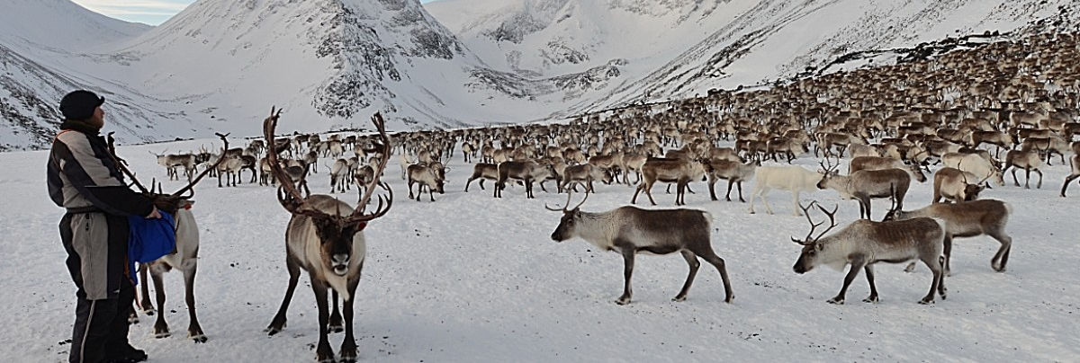
Other Cuture-Specific Items
Over 50% NPx
Over 50% ReflN
Identity: dáhpi ‘habit’ oahppu ‘education’ namma ‘name’ dáidu ‘art’
Livelihood: virgi ‘job/position’ eallu ‘reindeer herd/livelihood’
Animals: boazu ‘reindeer’
Identity: vuoigatvuohta ‘right’ geatnegasvuohta ‘duty’ eallinahki ‘lifetime’ ruoktu ‘home’
Livelihood: bargu ‘work/job’
Animals: heasta ‘horse’

Slide 22
Conclusions
North Saami has two possessive constructions
NPx = Noun + Possessive suffix, high morphological complexity
ReflN = Genitive Reflexive Pronoun + Noun, compositional without added complexity
Simpler ReflN replaces NPx simultaneous with policies that removed Mid Generation speakers from L1 environment during their school years ➔ Cog Lx helps document discrimination
Possession distinction is emerging with NPx marking inalienables, especially Kin, Products, and culture-specific items ➔ N. Sámi contributes to understanding inalienability

Slide 23
References
Bally, Charles. [1926] 1996. The expression of concepts of the personal domain and indivisibility in Indo-European languages. In: Hilary Chappell & William McGregor (ed.) The Grammar of Inalienability. A Typological Perspective on Body Part Terms and the Part-Whole Relation. Berlin/New York: Mouton de Gruyter, s. 31–61.
Chappell, H., McGregor, W. 1996. Prolegomena to a theory of inalienability. In: Hilary Chappell & William McGregor (ed.) The Grammar of Inalienability. A Typological Perspective on Body Part Terms and the Part-Whole Relation. Berlin/New York: Mouton de Gruyter, s. 3–30.
Croft, William 1990. Typology and Universals. Cambridge University Press.
Dixon, R. M. W. 2009. Grammatical Topics, Oxford University Press.
Haiman, John. 1983. Iconic and economic motivation. Language 59(4), s. 781–819.
Haiman, John. 1985. Natural syntax : iconicity and erosion. Cambridge University Press.
Heine, Bernd. 1997. Possession. Cambridge: Cambridge University Press.
Janda, Laura A. & Lene Antonsen. 2016. The ongoing eclipse of possessive suffixes in North Saami: A case study in reduction of morphological complexity. Diachronica 33:3, s. 330–366.
Lévy-Bruhl, L. 1914. L’expression de la possession dans les langues mélanésiennes. Mémoires de la Société de Linguistique de Paris, 19 (2), s. 96–104.
Nichols, J. 1988. On alienable and inalienable possession. In: W. Shipley (doaimm.), In Honor of Mary Haas: From the Haas Festival Conference on Native American Linguistics, 557–610. Berlin: Mouton de Gruyter.
Nichols, J. 1992. Linguistic Diversity in Space and Time. University of Chicago Press.

